Slide 1
Advance Internship@Clevered brAIn map
App User Manual
Author: Maheka Nath

Slide 2
Table of Contents
About me
About the app
Steps to use the app
My internships experience
Acknowledgements
Contact me

Slide 3
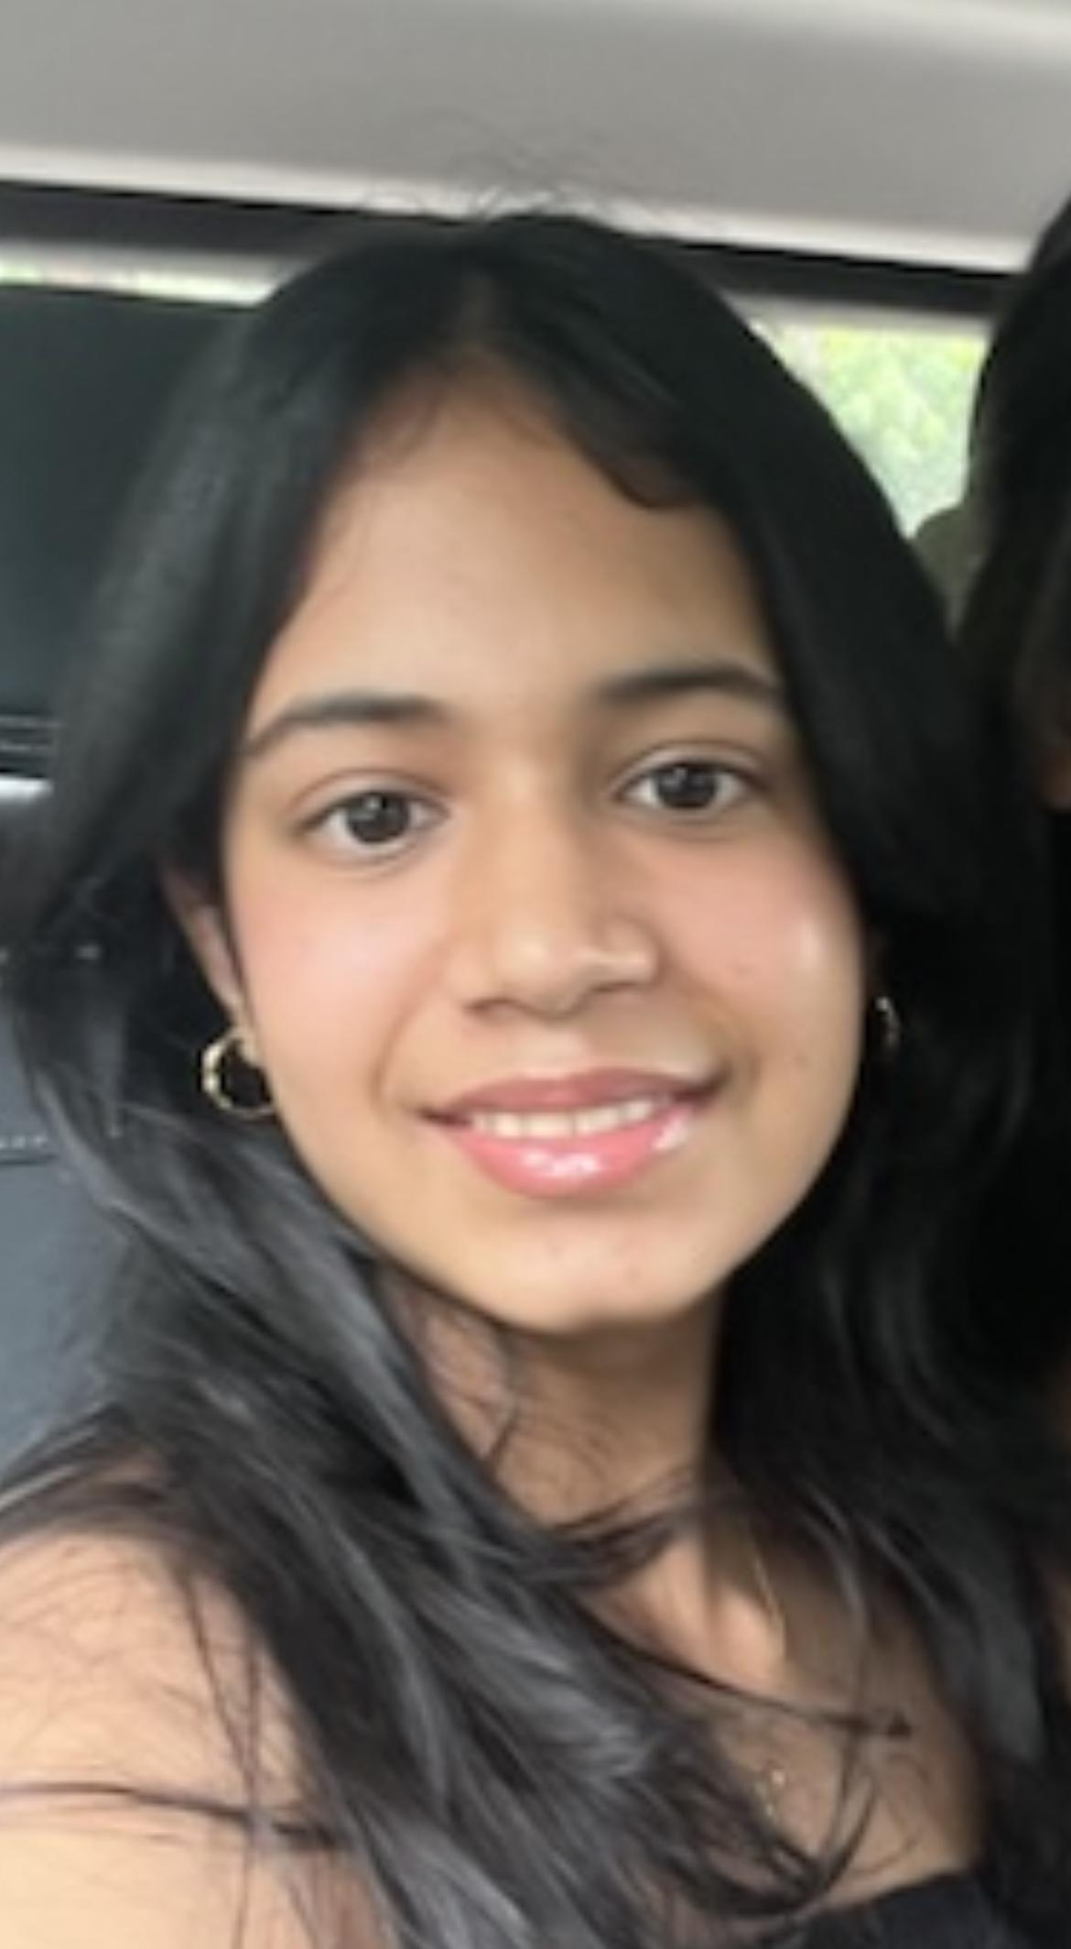
About Me..
My name is Maheka Nath, I am from New Delhi, India and am currently studying math, economics, political science and psychology. I developed a passionate interest in computer science and AI in the ninth grade and since then have taken many courses on computer science to enhance my knowledge.

Slide 4
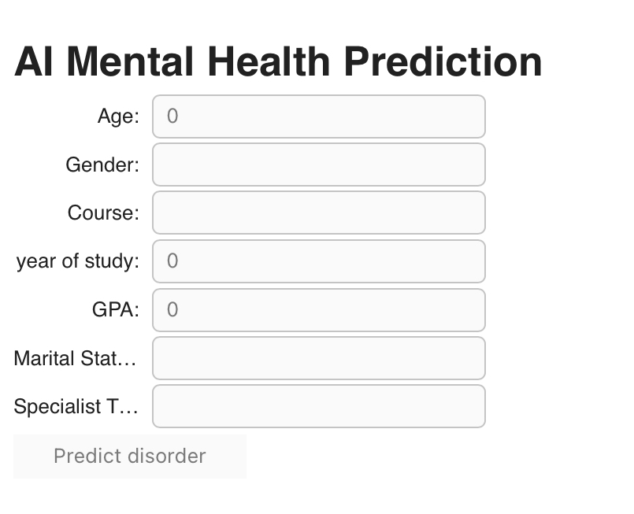
About App..
BrAIn map is an application which provides you with a structured questionnaire to assess whether someone has a disorder. This helps keep your mental health in check and ensures that you seek professional help if needed.

Slide 5
How do I use the App?

Slide 6
select age
The user’s age needs to be entered in the box.
Good internet connection and the use of google collab is required.

Slide 7
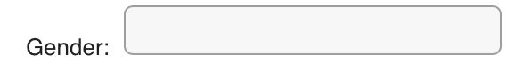
select gender
The user’s gender needs to be entered in the box. This can be male, female or other.
Good internet connection and the use of google collab is required.

Slide 8
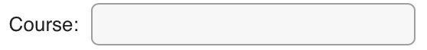
Select course
The user has to enter the course they are studying in the box.
Good internet connection and the use of google collab is required.

Slide 9
select year of study
The user’s year of study needs to be entered in the box.
Good internet connection and the use of google collab is required.

Slide 10
select gpa
The user’s grade point average needs to be entered in the box.
Good internet connection and the use of google collab is required.

Slide 11
select marital status
The user’s marital status has to be entered in the box. The user can enter ‘no’ if not married and ‘yes’ if married
Good internet connection and the use of google collab is required.

Slide 12
select specialist treatment
The user has to mention whether they have received a professional diagnosis for any mental health disorders.
Good internet connection and the use of google collab is required.

Slide 13
predict button
Once the data is filled out, the user has to click on the predict button at the bottom of the questionnaire to find out what mental health disorders the user is susceptible to.
Good internet connection and the use of google collab is required.

Slide 14
About My Internship with Clevered..
During my internship, I was able to understand how computer science can be used to solve real world problems. After some trial and error, I was able to complete the app and had help from my teacher every step of the way. It has helped built upon my interest for computer science and has given me clarity as to how technology can be used to solve problems.
Badges Earned: Wonderful effort for project completion and attentiveness.

Slide 15
Acknowledgements
I would like to offer a small vote of thanks for all who have helped me in this journey of App Development –
I would like to thank my parents for their support.
Ms Mani, who guided me through the project and helped answer my doubts.
Finally, I would like to thank Mr Ken for giving me his time and helping me with my project.

Slide 16
Contact Person
mahekanath@gmail.com

Slide 17
Thank you!

